Slide 1
Intercultural Communication Course for Delaware Technical & Community College Students
Project Management Plan
Olga Usova
DETT 607
Assignment 4: Project Management Plan
November 30, 2018

Slide 2

Overview
Present analysis results
training solution
Project strategy
Course objectives
Course content
Course analysis and required resources
- ESTIMATED RETURN ON INVESTMENT
PROPOSED SCHEDULE
POTENTIAL RISKS AND RECOMMENDATIONS
Present course status
References

Slide 3
Present analysis results
Many international students from different courtiers attend Delaware Technical & community college. The college offers a Communications degree that is heavily oriented on media studies and journalism where the students are expected to apply clear and compelling communications skills during interviews, use critical thinking to solve problems and demonstrate professional and ethical conduct.
Although the communications degree students study the same media applications and the same communications skills, some of them are experiencing difficulties grasping those skills.
We interviewed the Chair of the Communications Department, Rob Rector, and one of the primary instructors for the degree, Jessica Farley Dolnack. In our interview, we asked them what seems to be the problem.
According to Rector, besides the language barriers, the main reason for such a big gap in communication between foreign and in-state students is often between individualistic vs. collectivistic cultures. The U.S. is an individualism-based culture while cultures like Russia, Asia, Central America, South America, and Africa tend to be more collectivistic (R. Rector, personal communication, October 10, 2018).

Slide 4
Training solution
Training
Solution
In the analysis, we identified the need for an Intercultural Communication course online for Delaware Technical & Community College Communications Department students who study journalism and interact with people from different cultures on an everyday basis.
The proposed solution is to design, develop, and deliver a distance education Intercultural Communication course through the college’s existing D2L (Desire2Learn) platform. The rationale for this course is supported by the analysis of the Communications program and the target learner population needs.
Our Intercultural Communication course will address:
- the basics of effective communication,
- cultural shock concept,
- hidden biases in the workplace,
- family and social venues that have an adverse effect on the interaction between different social groups.
The course will immerse the students in activities that provide preventative measures from hidden biases, stereotypes, and prejudices to be effective communicators within various cultural groups.
The college President, the Chair of the Communications department, other faculty representatives from Communications and Psychology Departments will serve as the pilot class participants. Based on their feedback, the recommended changes will be incorporated into the course before it will be fully offered to the students as an elective course.

Slide 5
Project strategy
Analysis
* Audience and their characteristics
* The new behavioral outcome
* Learning constraints
* Delivery options
* Online pedagogical considerations
* Timeline for project completion
Design
* Documentation of the project
* Instructional strategies
* Storyboard
* User interface design and user experience
* Visual design implementation
Development
* Develop and assemble the content assets
* Integrate technologies
* Pilot program
* Implement feedback
Implementation
* Training of the facilitators and learners
* Training students on a new software/platform
* Course curriculum, learning outcomes, method of delivery, and testing procedures
Evaluation
Formative | Summative
Present on each stage of the model | Tests, assignments, opportunities for feedback
(Culatta, 2018)

Slide 6
Course objectives
Objectives | Assessment
• Identify different styles of communication, verbal and nonverbal, and their specifics within a culture. | This objective will be measured by a written assignment which will be a cultural autobiographical reflection graded according to a rubric. The students will have to achieve the grade of 70% to meet the objective and to demonstrate competency in acquired knowledge. The assignment will be worth 20% of the overall grade.
• Assess different cultural environments to become more effective communicators in a verity of cultural settings. | The students will lead a reflective journal on the situations presented in course material. At the end of the course, the students will be assessed on the journal content according to a grading rubric. The journal will be 30% of overall grade. The students will also be assessed on the collaborative participation. The overall participation in class will be worth 20% of their overall grade. Each week will be graded individually according to participation rubric.
• Conduct research and recognize cultural shock and biases, changes in small groups and organization levels, to be able to apply them in real life situations. | The students will have a group presentation assignment. They will be divided into groups of two. Each group will have to explore the cultural specifics and traditions of one culture and then present it in class. The presentations will be graded according to assessment rubric. The students will have to achieve the grade of 70% to meet the objective. The presentation will be 30% of the overall grade.

Slide 7
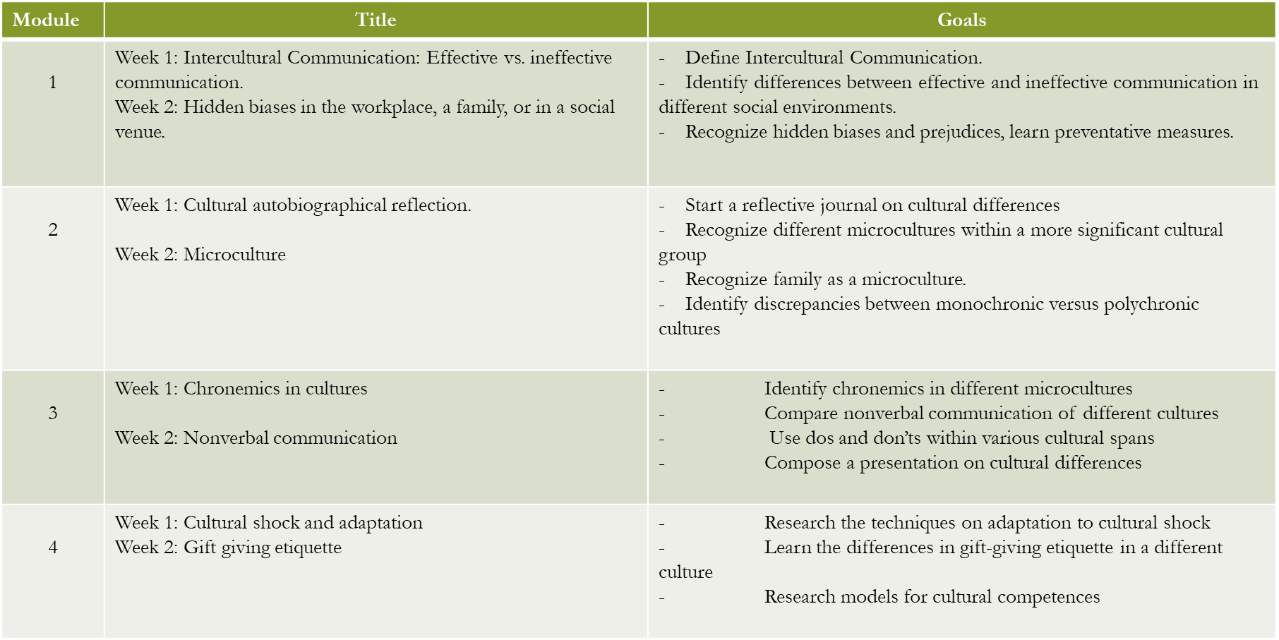
Course content

Slide 8
Cost Analysis and Required Resources

Slide 9
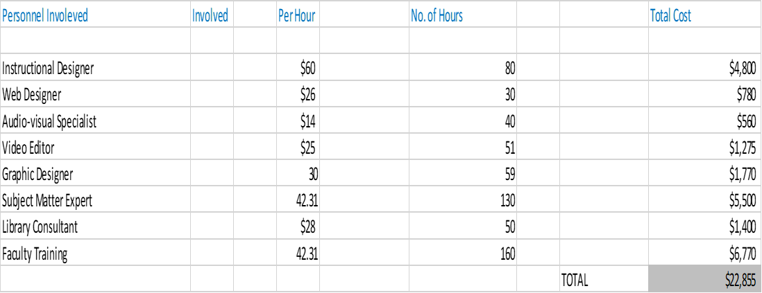
Cost analysis and Required Resources
* Development

Slide 10
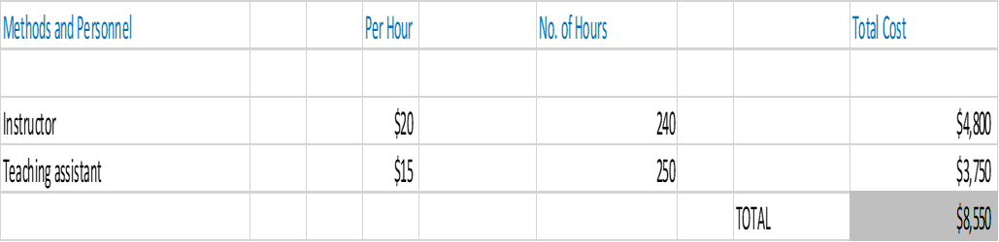
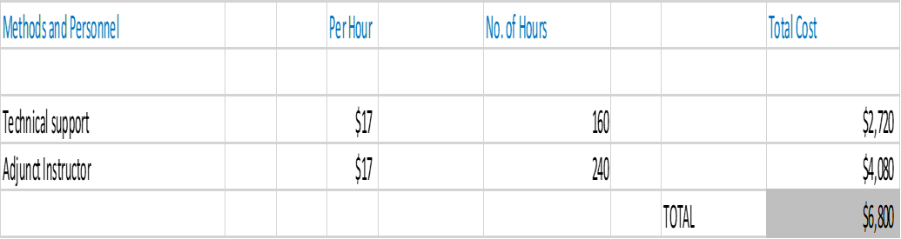
Cost analysis and Required Resources
* Delivery and Ongoing Operations Costs
Fixed Cost Items
Variable Cost Items

Slide 11
Estimated Return on Investment
Delaware Technical & Community College Tuition Fee is $149.50 per credit hour, which is $149.50 X 3 = $448.50 per course.
Full-time students usually take 12 credits per semester or 4 classes. $448.50 X 4 = 1794 per student per semester. If we assume each online classroom has the maximum number of students, which is 25, then a course will make $44, 850.
Let’s say each student takes 4 classes per semester. Then there are about 8 semesters to complete an associate degree, or about 5 courses taught per semester per program as it takes 40 courses to complete the whole degree. Now we can multiply $44, 850 by 5 (the number of courses taught per semester per program), the result will be $224,250 and can be made if 25 students attend each course, considering there are 5 courses per semester for the entire program, and the students need 40 credits to obtain a degree.
The entire cost for the online program technology development would be $ 56,674 (technology costs with platform fees and tech support) added to the entire program delivery per semester $1,334,200, and also added to course delivery and maintenance per semester as well - $614,000.
$56, 674 + 1,334,200 + 614,000 = $ 2,004,874
So, if we make $224, 250 per semester in total out of the entire 5 courses, notice we maximized the number of students to 25, then it will take about 9 semesters with the maximum number of 25 students to start making profit.
$ 2,004,874: $224,250 = ~9

Slide 12
PROPOSED SCHEDULE

Slide 13

POTENTIAL RISKS AND RECOMMENDATIONS
Potential Risks | Recommendations
Last minute rewrites from Pilot program observers | All parties must approve the course. One month between the pilot course and the actual course implementation will be available to put finishing touches on the course.
D2L platform technical difficulties | Conduct platform testing prior to the pilot course implementation.
Missed deadlines | The designers will insure to request enough time before the announcement of the course.
The investors will not be satisfied with profit return. | Make Intercultural Communication a required course of the Communications Department.
Not enough students sign up for the course | Implement an extensive marketing program to ensure the students outside the Communications Department know about the class.

Slide 14

Present course status
Work Completed:
Learner needs, context and analysis
Document design
Presentation to college designers and stakeholders
Course Module uploaded to D2L platform
Work to be completed:
Design the remaining course modules
Approval of the remaining modules
Storyboard for peer review
Peer review
Upload to D2L platform
Pilot course Implementation

Slide 15
references
Bureau of Labor and Statistics. (2018, April 13). Librarians: Occupational Outlook Handbook: U.S. Bureau of Labor Statistics. Retrieved from https://www.bls.gov/ooh/Education-Training-and-Library/Librarians.htm
Culatta, R. (2018). ADDIE Model. InstructionalDesign.org. Retrieved from https://www.instructionaldesign.org/models/addie/
How much does it cost to create an online course? (2018). Raccoon Gang. Retrieved from https://raccoongang.com/blog/how-much-does-it-cost-create-online-course/
Hulsmann, T. (2004). Costing open distance learning. Retrieved fromhttp://www.c3l.uni-oldenburg.de/cde/COLproject/web-col/index.htm
Pay Scale. (2018). Adjunct Professor Salary. Retrieved from https://www.payscale.com/research/US/Job=Adjunct_Professor/Salary
Quality Matters. (2018). Higher Ed Course Design Rubric. Quality Matters. Retrieved from https://www.qualitymatters.org/qa-resources/rubric-standards/higher-ed-rubric
Quality Matters. (2018). Online Instructor Skills Set. Quality Matters. Retrieved from https://www.qualitymatters.org/qa-resources/rubric-standards/teaching-skills-set

